Slide 1
CARE4Mind Conceptual Frameworks
Javed Mostafa
November 1st, 2023

Slide 2
Data and AI for Care: Need to be Multi-faceted and Multi-layered
Healthcare traditionally has been highly top-down and centralized: anchored primarily on the providers’ setting, i.e., where doctors, nurses, and social workers work
Information systems today are monolithic, centrally controlled, and mainly provider- and health administrator-facing
Effective mental health demands a multi-layered approach, recognizing the patient, family members, community social support organizations, and partner vendors (e.g., gyms, groceries, work-places, other specialist providers or ancillary health services) as critical stake holders in the care delivery ecosystem
The AI and data systems need to be multi-faceted, incorporating aggregation, management, and manipulation tools that cover clinical, biological, family, community, and environmental data

Slide 3
Two Conceptual Frameworks: Systems level and Operational (services) level
For the systems level we will need to expand beyond today’s Electronic Health Record platforms that focus on clinical data elements and tend to be primarily provider- and administrator-facing; the framework
Must incorporate social-determinants of health data
For the operational level framework, which is concerned with design, deployment, ongoing operations, and long-term sustainability we must engage all the key stakeholders; the framework must follow:
User-centered design and refinement
Inclusion, equity, transparency, explainability, and fairness
Long-term sustainability

Slide 4
A Multi-layered View of Mental Health Contexts
Community & Environment
Geographic and Physical
Environment
Social Environment
Systems & Services
Family
Family Dynamics
Family Structures
Household Composition
Self
Socio-demographic
Personality Traits
Identity
Trauma & Adversity
Physical & Psychological

Slide 5
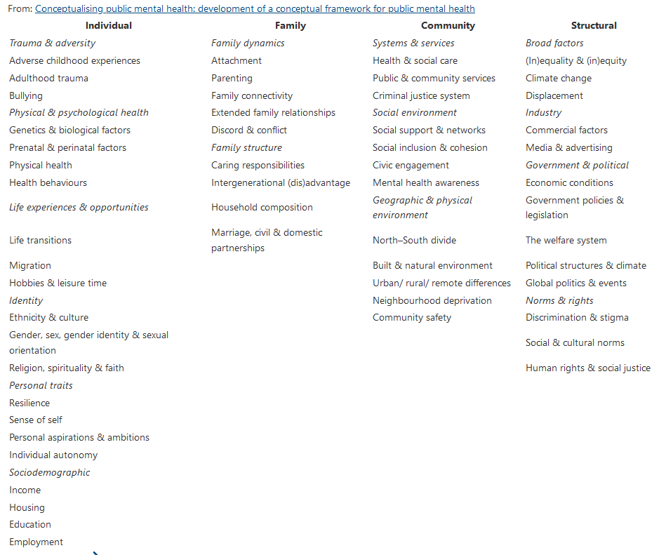
Multi-layered View of Healthcare Data

Slide 6
Systems Framework: From multi-layered contexts to multi-faceted data and AI systems
Clinical & Biological
Self
Family
Community & Environment

Slide 7
Systems Framework: Multi-faceted Data and AI
Multi-level Process for Risk Stratification and Monitoring, Interventions, and Evaluation
Machine Learning to Establish Risks and Health Status
Machine Learning at the Intervention Level
Medical history / chart (MD)
Biomedical/clinical Risk Factors
Influence of medical, clinical, behavioral, biological, and neurological factors on the elevation of risk and vulnerabilities to mental illness
Three Key Targets
Clinical Decision Support (CDS) for Providers
Fine grained formative and summative evaluation that establish individual and combined impact of CDS, awareness/alerts, education, and engagements of providers, patients, family, and community members on establishing risks and health status associated with three target areas (anxiety/stress, depression, and addiction)
Clinical data (CD)
Behavioral instruments (BD)
Clinical level anxiety and sustained stress
Tailored awareness, education, and motivation for patients
Biological/genetic labs (LD)
Imaging/neurological labs (ND)
Educational status (EDD)
Non-self (family, community, environment) Risk Factors
Influence of family, social circle, community, and environment on the elevation of risks and vulnerabilities to mental illness
Depression
Tailored awareness for community and social support personnel
Economic status (ECD)
Social Community Support (SCD)
Transportation (TD)
Addictive behavior
Combined and intersecting activities for providers, patients, family, and community personnel
Food and nutrition (FND)
Data Aggregation
Clinical and Social
Determinants
Phenotyping
Feature Engineering
Outcomes
Stratification /
Classification
Intervention &
Influence
Alerts, awareness,
Education and actions
Evaluation

Slide 8
Operational Framework: Shared Decision Making and Practical Robust Implementation and Sustainability Model (SDM-PRISM)
Drawing on the advances from implementation science, the CARE4Mind project will utilize a theoretical
framework which combines elements of the Shared Decision Making (SDM) and Practical Robust Implementation
and Sustainability Model (PRISM) – usually referred to as the SDM-PRISM model. The creators of the latter two
models have shown that SDM when appropriately applied can empower patients,
expand their awareness, improve accuracy of risks associated with their conditions, influence positive change
in their behavior, and ultimately achieve improved patient reported outcomes. Based on a growing body of
evidence they demonstrated also that the PRISM portion of the model: 1) can ensure the appropriate
interventions as related to established evidence (i.e., fidelity of interventions) and 2) allows the adaptation of the
intervention to suit each local setting, available resources, and most importantly individual patient needs. When
jointly followed, SDM-PRISM, can not only ensure efficacy but can engender a closer focus on measurement of
outcomes, achieve desired outcomes and reach scalability, and ultimately ensure dissemination and sustainability.
A. S. L. Tan et al., “Designing Shared Decision-Making Interventions for Dissemination and Sustainment: Can Implementation Science Help Translate Shared Decision Making Into Routine Practice?,” MDM Policy & Practice, vol. 3, no. 2, p. 238146831880850, Jul. 2018, doi: 10.1177/2381468318808503.

Slide 9
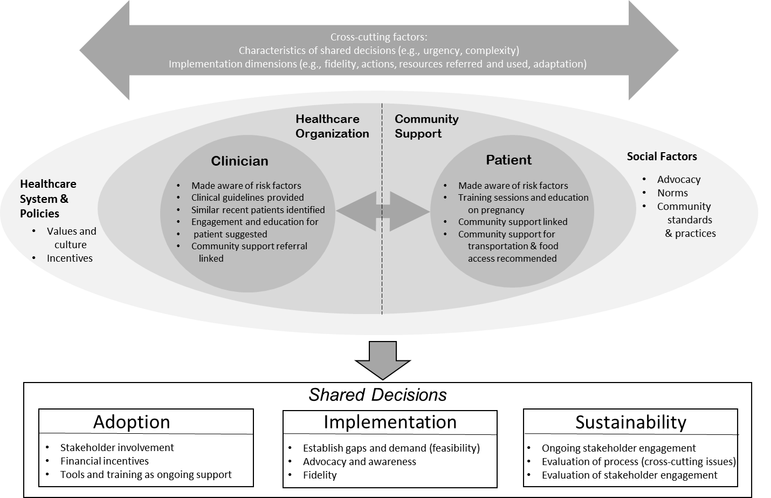
Shared Decision Making and Practical Robust Implementation and Sustainability Model (SDM-PRISM)

